Slide 1


For Mac Users: Best Practices: Step-by-Step Guide To Customizable Graphics
Edit/customize the graphic to best serve your constituency. There are two versions of each graphic, one that is ready to publish and one that is customizable – allowing for you to insert a specific logo and any text you’d like.
Once you’ve designed a graphic, please follow the following steps.

Slide 2
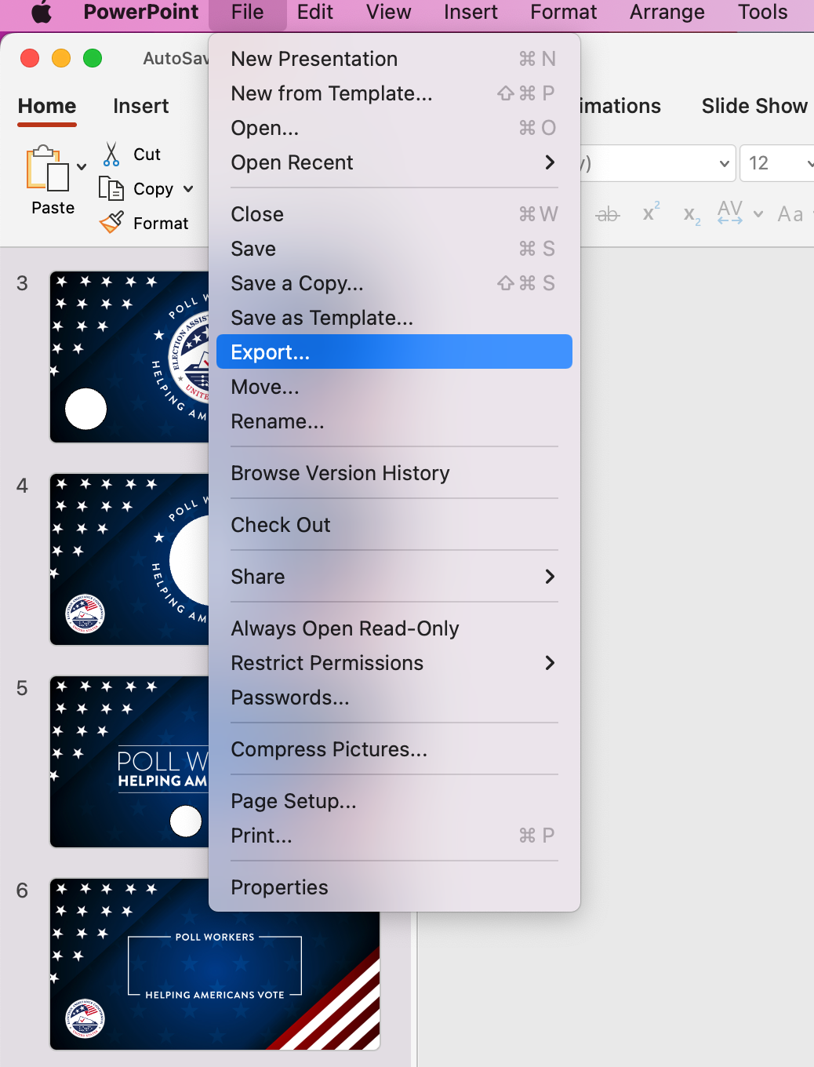
Step 1: Click File, then Export

Slide 3
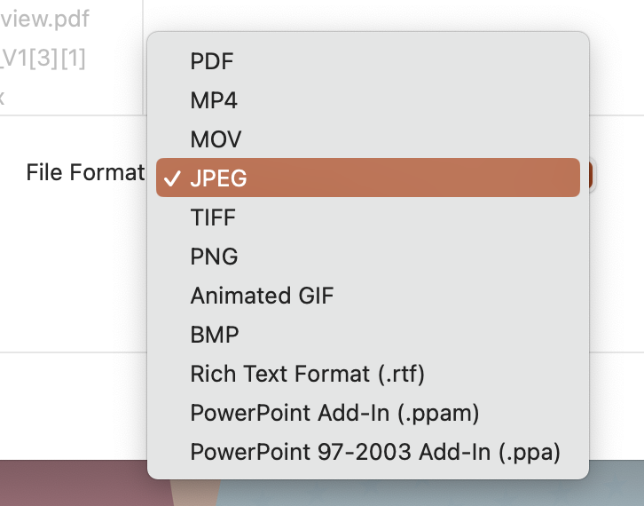
Step 2: Select .JPG

Slide 4
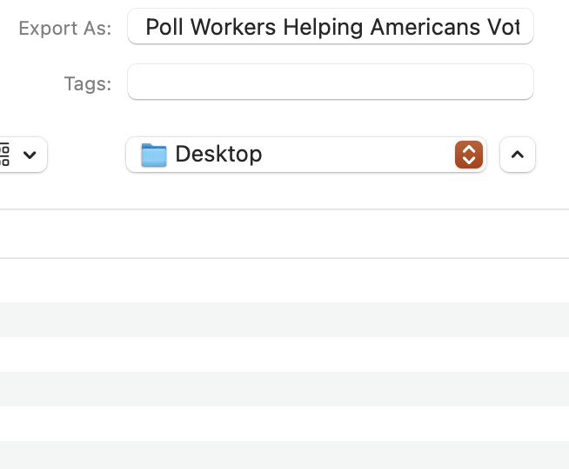
Step 3: Save Your New Graphic Step 4: Don’t Forget to Use the Hashtag #HelpingAmericansVote

Slide 5
For Windows Users: Best Practices: Step-by-Step Guide To Customizable Graphics
Edit/customize the graphic to best serve your constituency. There are two versions of each graphic, one that is ready to publish and one that is customizable – allowing for you to insert a specific logo and any text you’d like.
Once you’ve designed a graphic, please follow the following steps.

Slide 6
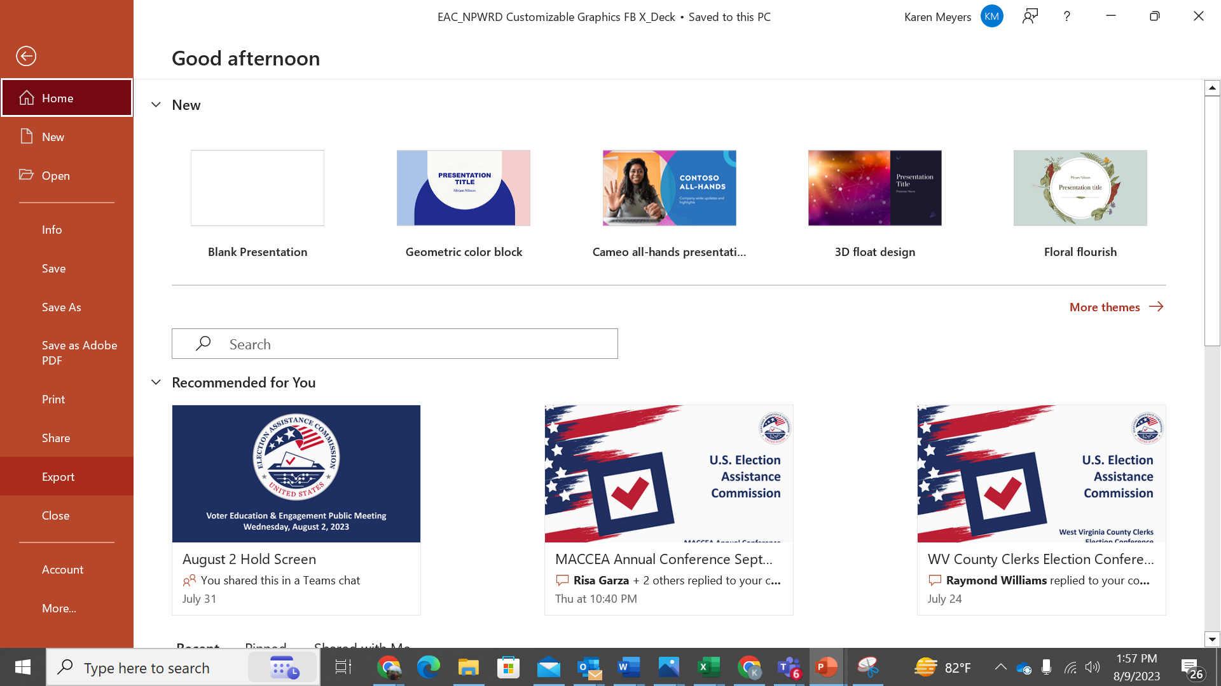
Step 1: Click File, then Export

Slide 7
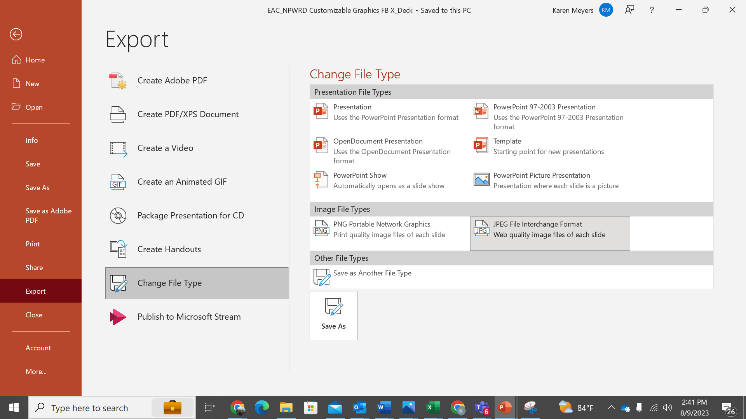
Step 2: Click Change File Type

Slide 8
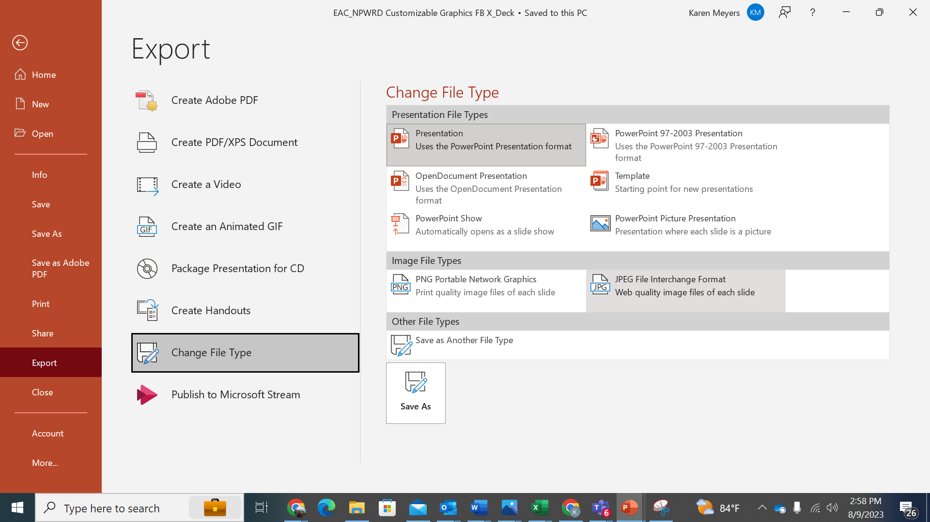
Step 3: Under Image File Types, Select .JPG

Slide 9
Step 4: Save Your New Graphic Step 5: Don’t Forget to Use the Hashtag #HelpingAmericansVote

Slide 10
EXAMPLES

Slide 11



Slide 12




Slide 13

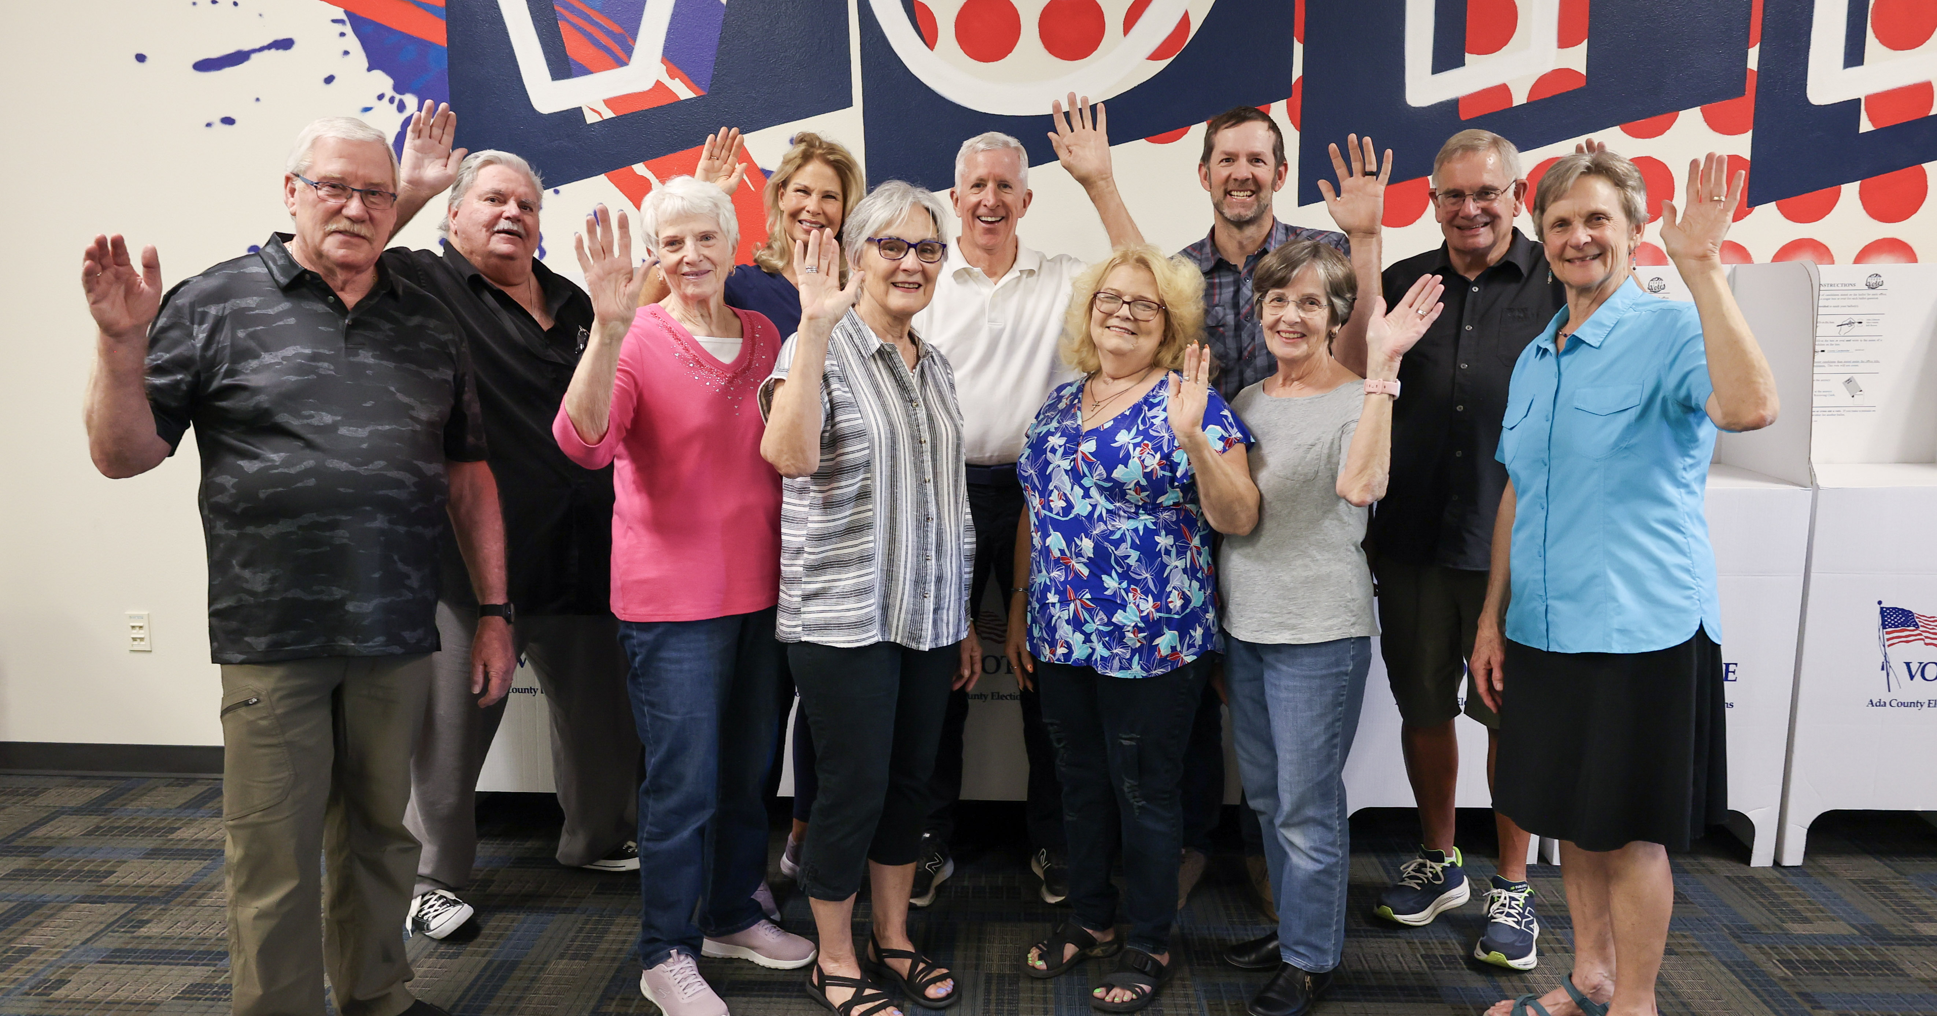


Slide 14


Slide 15
TEMPLATES

Slide 16


Slide 25


Slide 26


Slide 29
Notes:
f

